Slide 1
Session: Sentiment Analysis on Amazon Reviews
For enhancing customer satisfaction, improving product development, and optimizing marketing strategies.
Presenter: Jayantilal Bhanushali
Duration : 45 Mins

Slide 2


Speaker – Jayantilal Bhanushali (Jay)
10 years of full-time experience in Business analytics, Machine learning & Digital transformation
Worked with multiple Fortune 500 companies from FinTech, Insurance, Banking, Energy, Supply Chain, Retail (CPG) etc.
6+ years of consulting and training experience in Data Science
Post Graduate in Applied Statistics and Bachelors of Engineering in Information Technology from University of Mumbai.
/in/Jayantilalb

Slide 3
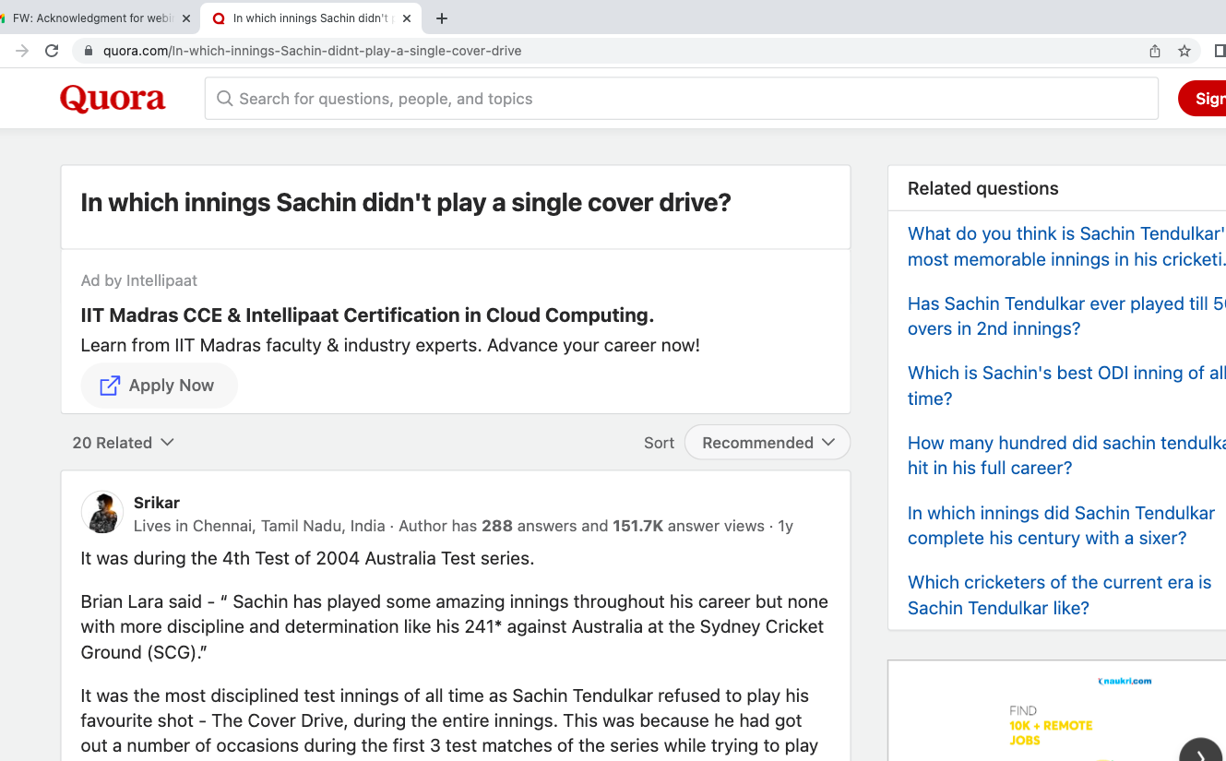
In which innings Sachin didn’t play a single cover drive ?
Ref: https://www.quora.com/In-which-innings-Sachin-didnt-play-a-single-cover-drive

Slide 4
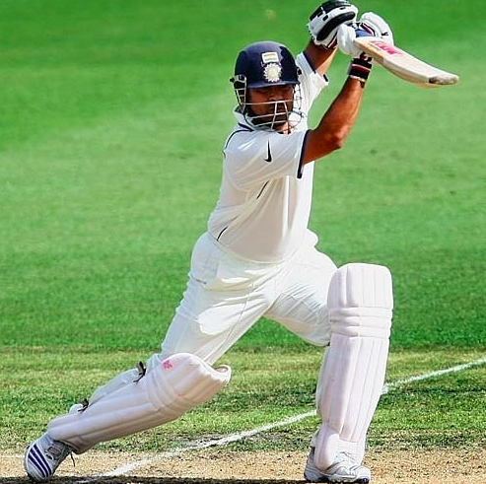
Sachin Tendulkar | Sydney 2004 |
The master batsman was going through an extremely lean patch, scoring just 88 runs from the first 3 Test matches of the series. In his 5 innings he had registered 3 single-digit scores including 2 ducks. But the Sydney knock changed it all for him as the world stood up and took notice of Tendulkar's genius once again.
Ref: https://www.quora.com/In-which-innings-Sachin-didnt-play-a-single-cover-drive

Slide 5
Sachin Tendulkar | Sydney 2004 |
Brian Lara said - “ Sachin has played some amazing innings throughout his career but none with more discipline and determination like his 241* against Australia at the Sydney Cricket Ground (SCG).”
It was the most disciplined test innings of all time as Sachin Tendulkar refused to play his favourite shot - The Cover Drive, during the entire innings.
This was because he had got out a number of occasions during the first 3 test matches of the series while trying to play a Cover Drive off the ball bowled outside Off Stump. But Sachin showed his grit in this innings during the 4th Test, by leaving the balls bowled outside the Off Stump.
Thus he scored 241* off 436 balls without a single cover drive.
Ref: https://www.quora.com/In-which-innings-Sachin-didnt-play-a-single-cover-drive

Slide 6
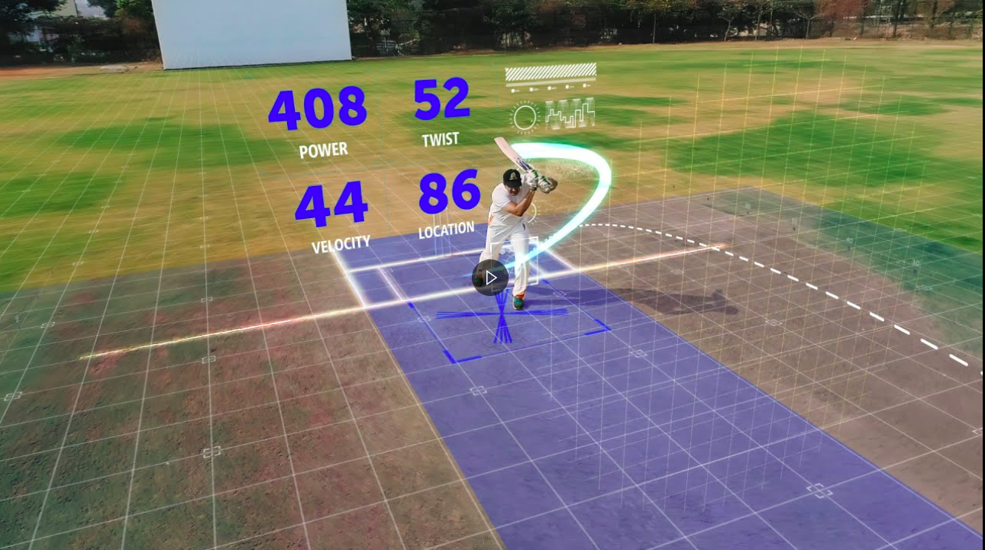
Can other batsman get this intuitiveness by power of data?
Spektacom, a sports technology company founded by Anil Kumble, is partnering with Microsoft to help cricketers, coaches, commentators, and even fans find the answer through real-time data in every swing.
Ref: https://inculture.microsoft.com/sports/spektacom/

Slide 7
So what is: Data Science?

Slide 8

What is your current level of understanding of Data Science?
(0 being Lowest and 5 being Highest)
#poll

Slide 9
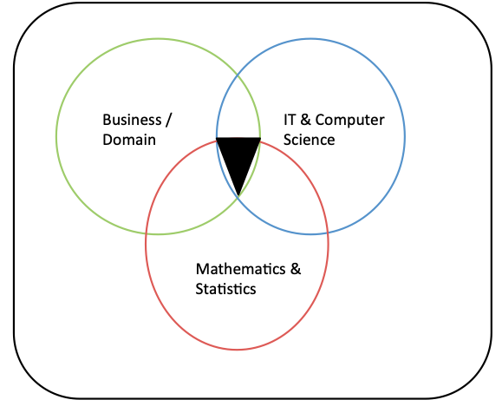
Data Science - Simplifying

Slide 10
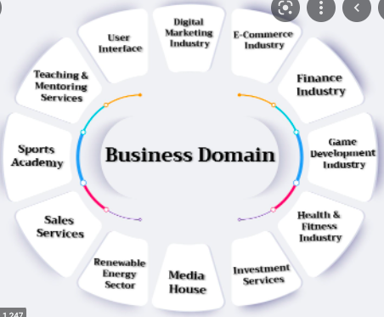


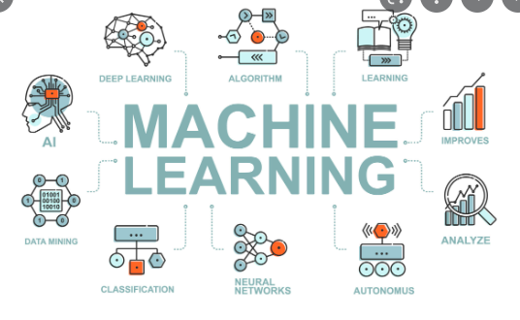
Data Science - Simplifying

Slide 11
Data Science - Simplifying
Data science is an interdisciplinary field that uses Machine learning algorithms and computer programming to extract knowledge and actionable insights from noisy, structured and unstructured data via adding domain knowledge.
machine learning algorithms
computer programming
actionable insights
domain knowledge
interdisciplinary

Slide 12
Who is Data Scientist
Data science practitioners apply machine learning algorithms to numbers, text, images, video, audio, and more to produce intelligence systems to perform tasks that ordinarily require human intelligence or even beyond human intelligence. In turn, these systems generate insights which analysts and business users can translate into tangible business value.
numbers, text, images, video, audio
machine learning algorithms
human intelligence or even beyond human intelligence
intelligence systems & Insights
into tangible business value.

Slide 13
Industry
Banks
Media
Social Networking Sites
FMCG
Retail
Health Care
IT
Human Resources
Credit Cards
Consumer Research
Ecommerce
NGOs
Education
Transport
Entertainment
Stock Markets
Airlines
Investment funds
Defense
Supply Chain & logistics
Sports
Insurance
Telecom
Sales & Marketing
Tourism
Manufacturing
Hotels
Investment Banking

Slide 14

Demand & Supply of data scientist !
………time taken to hire engineers is 6 to 8 weeks, the time to hire data scientists is 11 to 14 weeks in comparison……..
The reason behind the vast supply gap and long hiring times can be traced back to existing gaps in the skillsets.
Ref: https://www.indiatoday.in/education-today/jobs-and-careers/story/career-outlook-for-data-scientists-in-india-sky-high-pay-and-rising-demand-1825991-2021-07-09

Slide 15
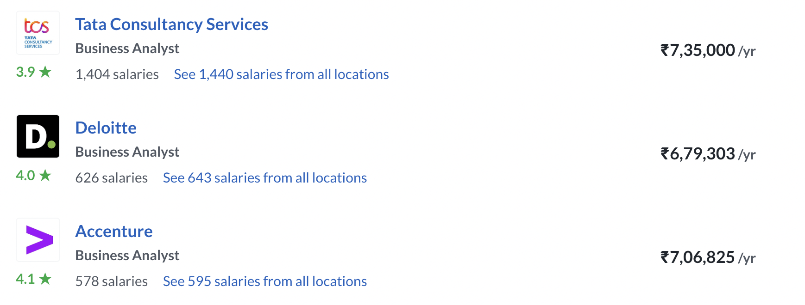
Salary Ranges – General
~15L | ~21L | 24L+
Mckinsey, BCG, Bain | Amazon, Flipkart | Google, Microsoft, PayPal
Analytics Consultant | Business Analyst | Product Analyst/ Data Analyst

Slide 16
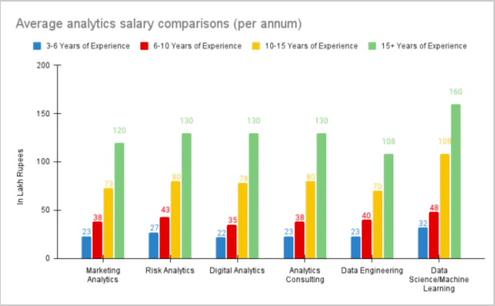
Salary Ranges – by Michael Page
According to recruitment firm Michael Page’s 2021 India Talent Trends report, data science professionals with 3-10 years of experience get annual salaries in the 25-65 lakh range, while those with more experience can command pay packages upwards of 1 crore.
Ref:: https://www.indiatoday.in/education-today/jobs-and-careers/story/career-outlook-for-data-scientists-in-india-sky-high-pay-and-rising-demand-1825991-2021-07-09

Slide 17
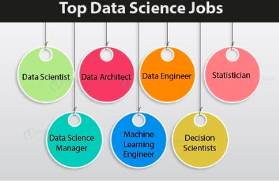
Job Profiles
Ref: https://za.pinterest.com/pin/40673202872278869/

Slide 18
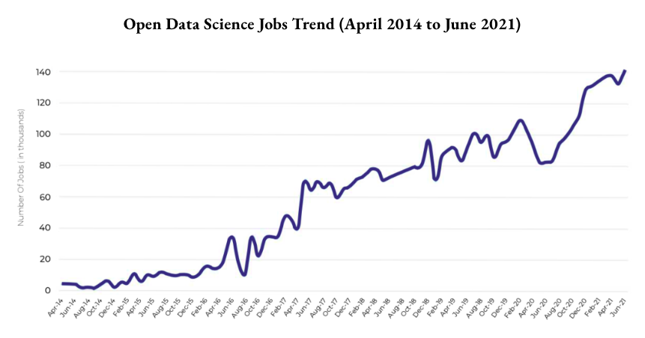
Recent Job trends in Data Science
https://analyticsindiamag.com/study-analytics-and-data-science-jobs-in-india-april-2021/

Slide 19
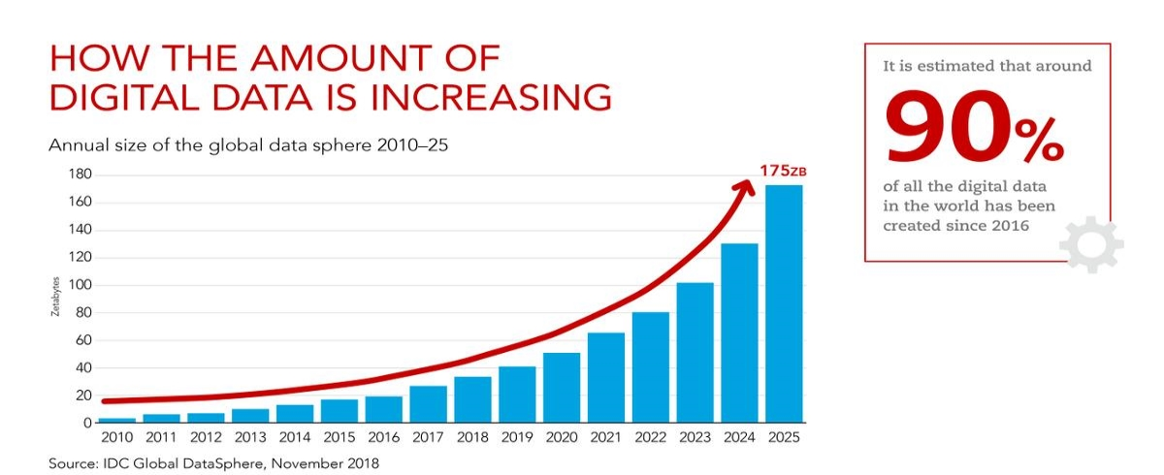
Why such increase in Data Science ?
“Every second of every day, our senses bring in way too much data than we can possibly process in our brains.”
– Peter Diamandis, Chairman/CEO, X-Prize Foundation.

Slide 20
With the penetration of Internet and Data, will the requirements of Data Scientists will Increase or Decrease?
#poll

Slide 21
Sentiment analysis for Amazon –
Enhancing customer satisfaction, improving product development, and optimizing marketing strategies.

Slide 22
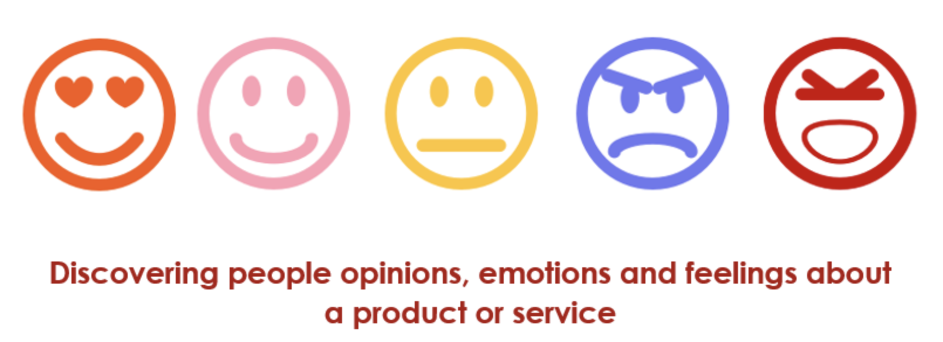
Sentiment Analysis
What is Sentiment Analysis
It refers to analysing an opinion or feelings about something using data like text or images regarding almost anything.
It is the process of classifying the text as positive ,negative and neutral.

Slide 23
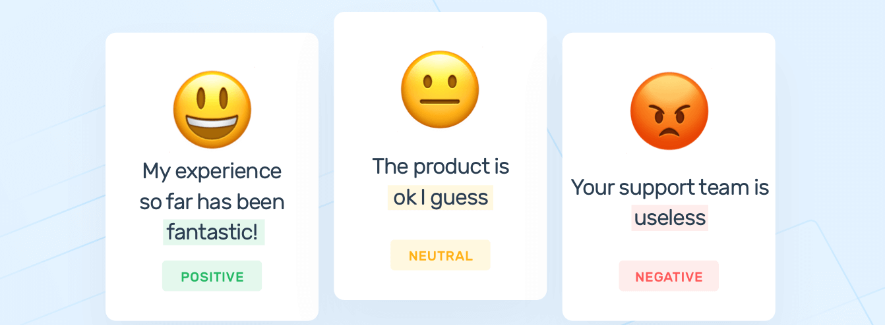
Sentiment Analysis
Why Sentiment Analysis:
Machines can read much faster than humans and in many languages too
We can train the machine to understand in structured manner whereas humans are subjective

Slide 24
Before buying anything or watch a movie, do you read reviews?
#poll

Slide 25
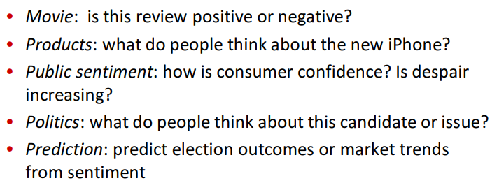
Applications of Sentiment Analysis
We can monitor brand sentiment online in real time.
Quickly detect negative tweets that mention your brand or any specific product
Understand the what customer needs , and make data based decision on the go

Slide 26
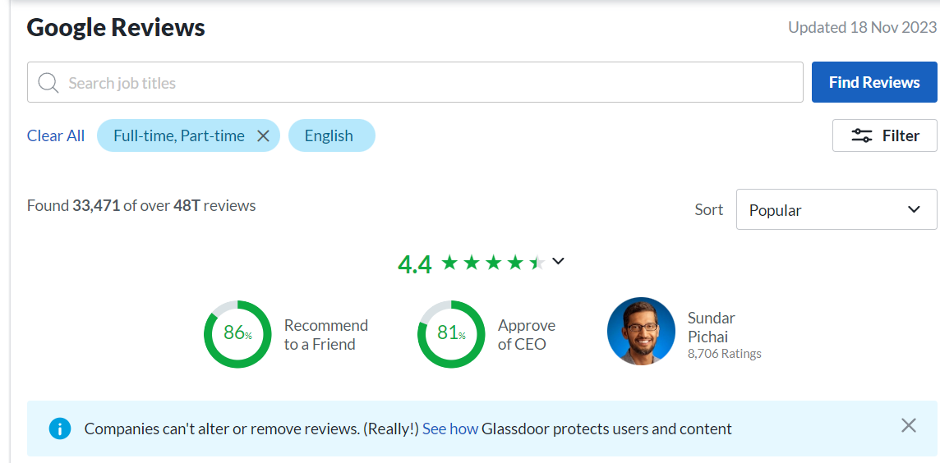
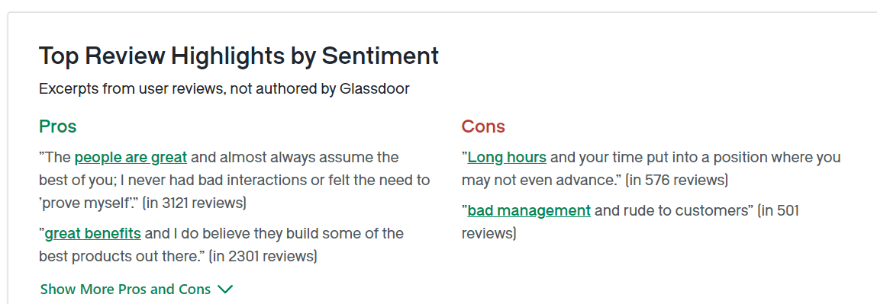
Applications of Sentiment Analysis

Slide 27
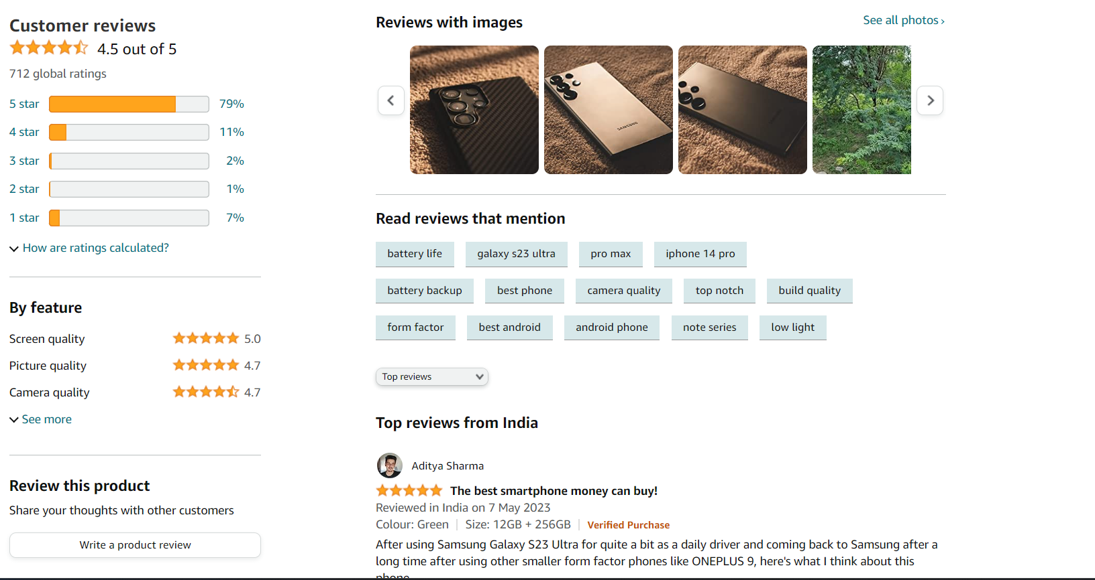
Applications of Sentiment Analysis

Slide 28
Sentiment analysis – Amazon Reviews
Let’s see it in Action!
Google Colab:
https://drive.google.com/file/d/1DTHloYsGT_BrOQ_nJjVmx7_Qb2gDB4uX/view?usp=sharing
GitHub:
https://github.com/jayantibhanushali007/Amazon_Sentiment

